Slide 1
Deliver session in small groups - key!
Works best if in a computer lab
Have the students open the sample test - link to test
Put Slideshow on projector
Provide a handout of slides for students so they can make notes
Go through slideshow each section at a time, while students try it out with the sample test
After, have a Q&A session while students play around with the test
Next session - have students try the “Secure Sample Test” in a setting just like the real test & use the multiple choice results as a formative or summative mark
Keys to a Successful Online Prep Session (Suggestions)...

Slide 2
Any Questions?
If you have questions, we are here to help you out!
helpdesk@dsbn.org
Subject line:
Online OSSLT - Test or Online OSSLT - Tech
Your email will be given the highest priority and directed to the appropriate person immediately

Slide 3
Online OSSLT
How to Guide for Students

Slide 4
Online OSSLT Pilot
October 20, 2016
As the October 20th OSSLT Online testing is a pilot, give it your best shot. It provides you experience with online tests. Also, feel secure in the knowledge that it only counts if you are successful. There is no penalty if you are not successful.

Slide 5
Benefits!
If you are successful...
If you are unsuccessful...
You are done with the OSSLT!
You’ll have met your graduation requirement!
You’ll have a free shot at seeing the test!
It doesn’t count against you!
You’ll be able to get support for the skills you need to practice!

Slide 6
Online OSSLT Practice
September 6th to October 19th
In an effort to improve your comfort level, you will be given an opportunity to try the Online OSSLT sample test from September 6th to October 19th.

Slide 7
Go to...
www.eqao.com
Click on sample online OSSLT

Slide 8
Navigation Instructions
General Instructions for Students
WATCH
VIDEO

Slide 9
Navigation Instructions
Reading Section Tip:
“Double Arrows” - Some Reading Sections have the text hidden behind the questions. To access the whole text, click the double arrows to ‘hide’ the question panel, and click the double arrows to reveal the question panel again.

Slide 10
Try it out!
Open the test
Try out the navigating tools
Next
Previous
Review
Flag
Practice makes permanent!

Slide 11
Tools
General Instructions for Students
WATCH
VIDEO

Slide 12
Tools
Highlighting Tool Tip:
ON
OFF
If you have the Highlighting Tool ON, be sure to click the Highlighting Tool OFF when responding to Multiple Choice questions and when typing in a Text Box.
Note: The highlights you create are attached to the question slide.
Notes:
Share ideas that we had during our July 11 conversation about crafty work arounds for using the highlighting feature. We should still recommend that kids use the highlighting strategy (if that is what they do on a regular basis). Even though the data from our last online pilot test suggested that kids don’t use the highlighting feature, we can’t conclude that kids don’t use highlighting as a strategy. It could very well have been a result of kids getting fed up with the fact that their highlighting disappeared as soon as they navigated off the page! Suggest to kids that they--like all good readers-- should read over all of the questions before they start to read the text. Their next step will be to read the text and highlight the text that they feel is important info that will help them provide answers to each question. Even though the highlighting doesn’t transfer over to the next question, the students can always click on the first question and see the highlighted text (it doesn’t disappear-- yay!)

Slide 13
Try it out!
Try out the tools
Magnifying Glass (zoom in & out)
Flag questions
Highlight
Practice makes permanent!

Slide 14
Writing Tools
General Instructions for Students
WATCH
VIDEO
Notes:
Please note
- right clicking to copy & paste DOES NOT work
- you cannot copy & paste from Notepad to Notepad - only to answer text boxes

Slide 15
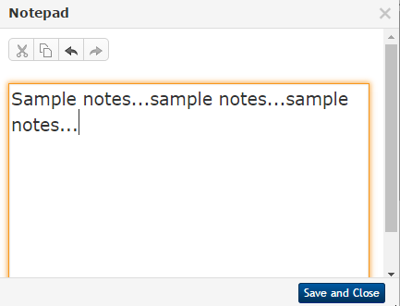
Writing Tools
Notepad Tip:
After typing notes in the Notepad, you may Copy and Paste your text into the Answer Text Box, either by using the Copy and Paste icons, or Ctrl C (Copy) and Ctrl V (Paste).
Note: If you have created a note on a slide, then navigate off of that slide, the note in your Notepad will be there when you return to your original slide - it is attached to the question.
Notes:
Please note
- right clicking to copy & paste DOES NOT work
- you cannot copy & paste from Notepad to Notepad - only to answer text boxes

Slide 16
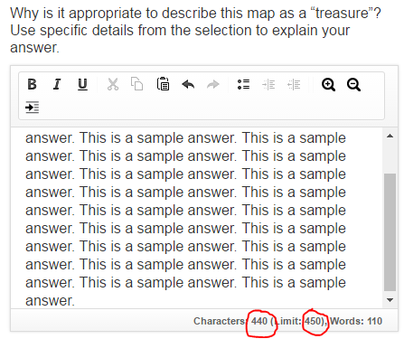
Writing Tools
Character Maximums:
Short Answer Questions:
450 Characters
News Report:
1250 Characters
Series of Paragraphs:
2500 Characters
Character Count Tip: The Text Box tracks characters and words typed and gives you a MAXIMUM NUMBER OF CHARACTERS for your written responses (similar to Twitter).

Slide 17
Try it out!
Try out the writing tools
Text box
Formatting options
Notepad
Character count
Word count
Practice makes permanent!

Slide 18
Multiple Choice Tools
General Instructions for Students
WATCH
VIDEO

Slide 19
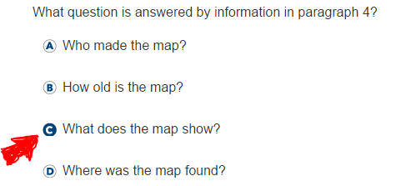
Multiple Choice Tools
To Answer Multiple Choice Questions:
Use your mouse to click on your Multiple Choice response.

Slide 20
Remember!
Highlighting Tool Tip:
ON
OFF
If you have the Highlighting Tool ON, be sure to click the Highlighting Tool OFF when responding to Multiple Choice questions and when typing in a Text Box.
Note: The highlights you create are attached to the question slide.
Notes:
Remember - when answering MC questions the Highlight feature has to be turned off in order to click your answer!

Slide 21
Try it out!
Try out the Multiple Choice Questions
Strikethrough tool
Highlighting tool
Select & change answers
Practice makes permanent!

Slide 22
Navigation Tools & Tips
For a two page tip sheet of all the Online OSSLT Navigation Tools and Tips click on the link below.
Online OSSLT Tools and Tips

Slide 23
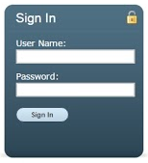
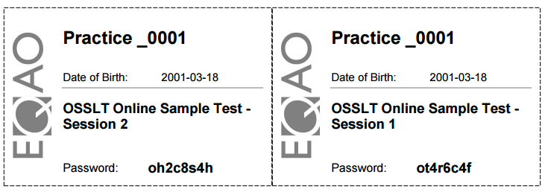
Getting Started...
Logging On and Signing In:
On the day of the OSSLT testing,
Log onto a DSBN device using your DSBN credentials.
Click on the EQAO Online Kiosk App on your desktop.
Sign in with your OSSLT username and OSSLT password as shown on your ticket.
or4r7s3f
or3b7s2g
Notes:
Note - this ticket has a fake password

Slide 24
Practice...
Now that you have seen the test & the tools, keep practicing using the online sample to get your skills in shape for October 20th.
See your teacher if you have any questions!
Good Luck!

Slide 25
Practice Time
Practice using the Online Sample Tests of the OSSLT.
Online OSSLT Sample Test

